Slide 1
Mental Health Promotion in Childhood
Manuja Perera
Department of Public Health

Slide 2
Mental Health
A state of well-being in which the individual
realizes his or her own abilities,
can cope with the normal stresses of life,
can work productively and fruitfully, and
is able to make a contribution to his or her community

Slide 3
Elements of Mental well-being
Enthusiasm
Variety of interest
Ability to handle stress
Self esteem
Creativity
Ability to make decisions
Aesthetic appreciation
Appreciation of beauty and excellence
- the ability to find, recognize, and take pleasure in goodness in the physical and social worlds

Slide 4


Slide 5

Notes:
Be simple…..

Slide 6

Notes:
Be in the present

Slide 7

Notes:
Learn to enjoy simple things……

Slide 8

Notes:
Enjoy nature

Slide 9

Notes:
Be positive……Every dark cloud has a silver lining

Slide 10

Notes:
Learn to enjoy your own company

Slide 11

Notes:
Have a healthy hobby…..

Slide 12
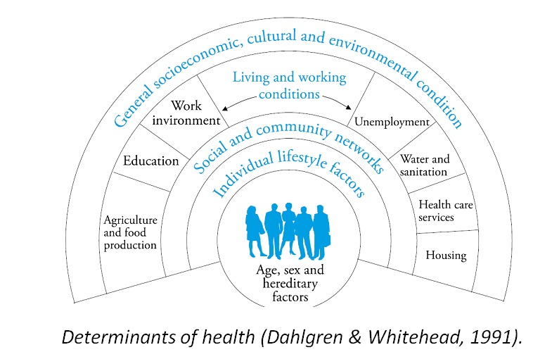
Promoting Mental Health

Slide 13

Promoting Mental Health
Childhood and Adolescence
- the key stages

Slide 14
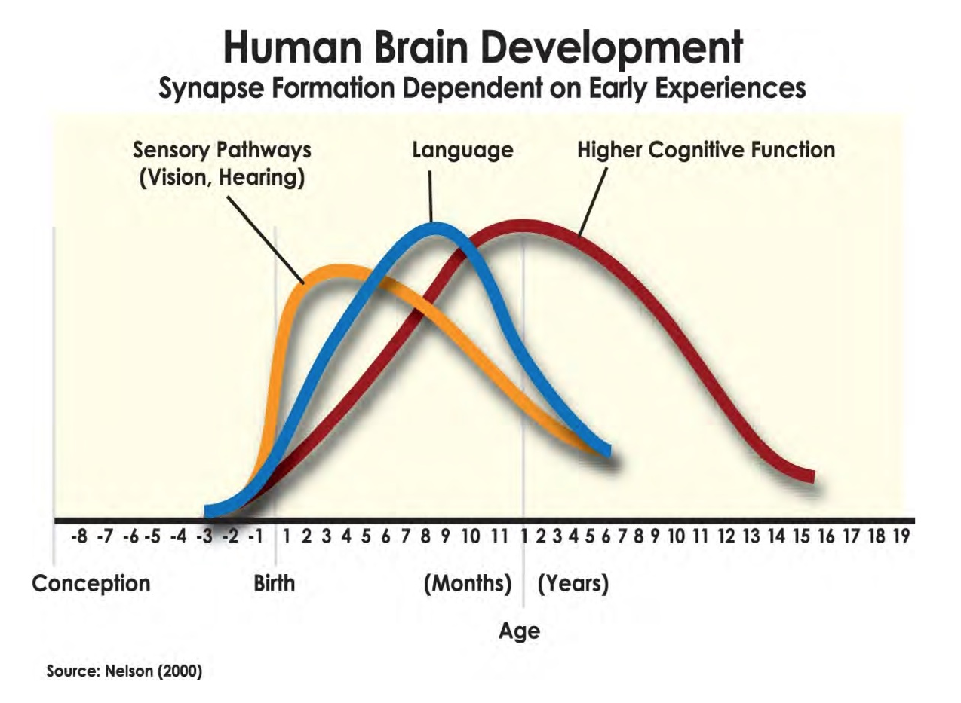
Early Childhood – The Foundation

Slide 15
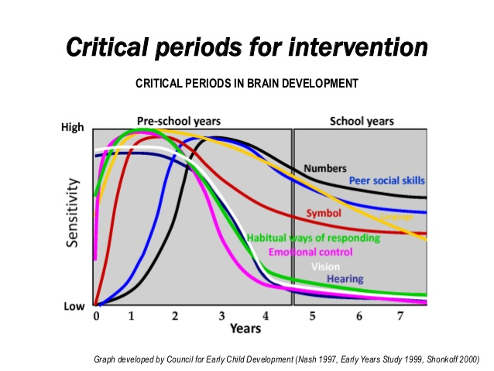
Early Childhood – The Foundation

Slide 16
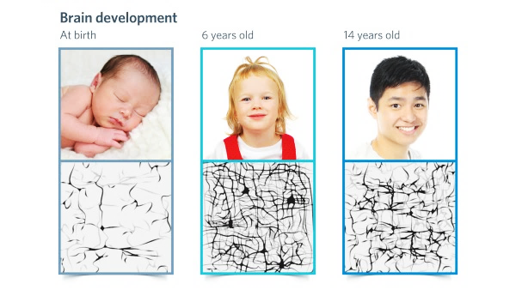
Adolescence – Use it or Lose it!

Slide 17
Promoting Mental well-being
Enthusiasm
Variety of interest
Ability to handle stress
Self esteem
Creativity
Ability to make decisions
Aesthetic appreciation
Home
Preschool
School

Slide 18
Promoting Mental well-being
Enthusiasm
Variety of interest
Ability to handle stress
Self esteem
Creativity
Ability to make decisions
Aesthetic appreciation
Parenting
Mentoring
Coaching

Slide 19

What is Mentoring?

Slide 20
What is Mentoring?
Mentoring is NOT:
Teaching/Giving instructions/
Telling what to do
Nor counselling!!!

Slide 21
What is Mentoring?
Mentoring is:
A process

Slide 22

Mentoring – Is a process
A partnership
That is:
empowering and supportive
open and honest
for the best of interests of the mentee

Slide 23
What is Mentoring?
Mentoring is:
Asking the right questions

Slide 24

Mentoring – Asking the right questions
1. To facilitate self-reflection
To Explore:
Needs & desires
Competencies
Potential
Motivators & inhibitors

Slide 25

Mentoring – Asking the right questions
2. To facilitate thought processes for change
To identify:
Goals
Actions
Changes required
Solutions

Slide 26
What is Mentoring?
Mentoring is:
Stimulating growth

Slide 27
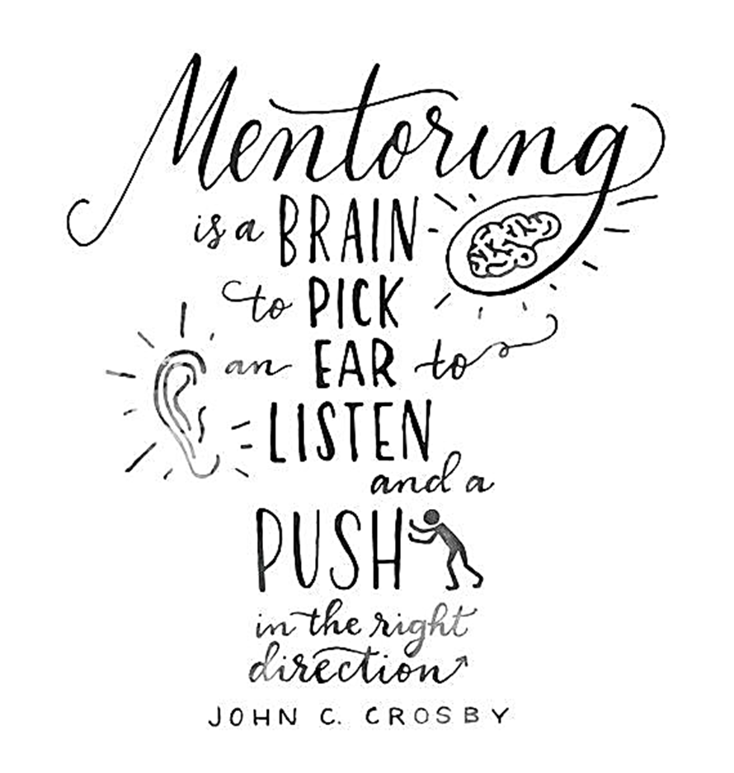
Mentoring – Stimulating growth
Encouraging:
commitment to action
personal growth
change
May include:
One-to-one training
Counselling
Even giving advice!!!

Slide 28

Mentoring Vs Coaching

Slide 29
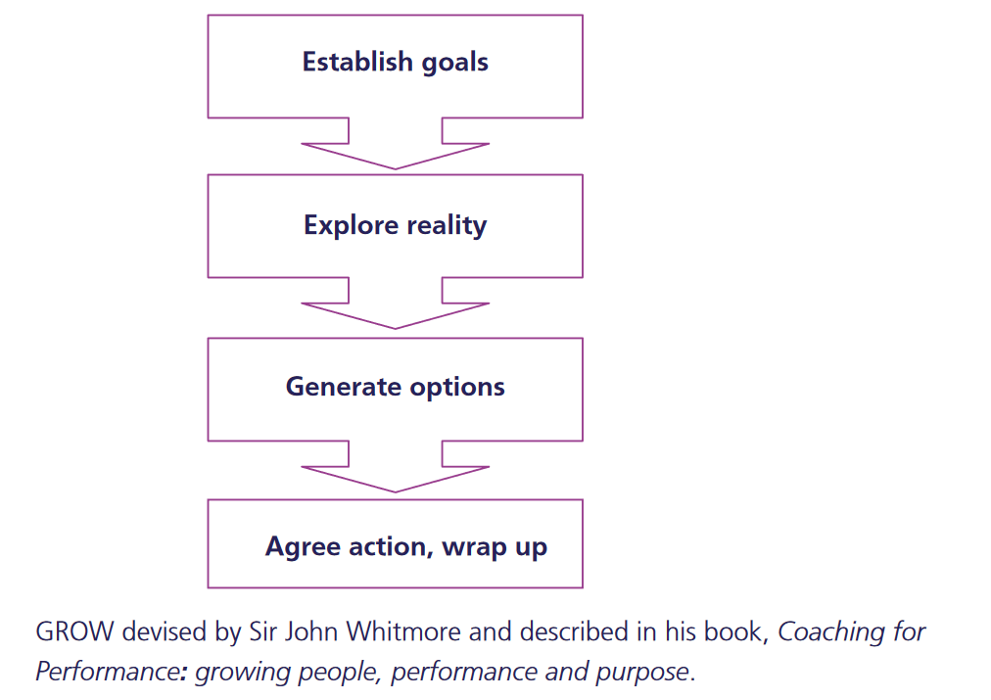
Mentoring Vs Coaching
GROW Model for coaching
Mentoring and coaching can be ‘stand alone’ activities, or be used to complement each other

Slide 30
Mentoring Vs Coaching
Mentoring:
A relationship based activity with specific but wide ranging goals
Does not have to be a formal process
Agenda is open and continues to evolve over the longer term
Seeks to build wisdom – the ability to apply skills, knowledge and experience to new situations and processes
Coaching:
The focus is on meeting specific objectives within a set time period
There is usually a planned programme
Mainly concerned with performance and the development of certain skills

Slide 31
Mentoring Vs Coaching
Mentor:
relies heavily on the questioning process.
is likely to have followed a similar career to the one their mentee is starting, and will pass on their expertise.
Coach:
is more likely to use direct feedback
is a specialist who works with the protégé on specific goals and objectives

Slide 32
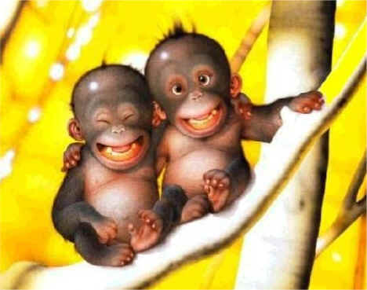
Thank You!
Questions?
Notes:
Keep on smiling………

